Slide 2

Photo: Carlos Jones/ORNL
[CC BY 2.0] via Wikimedia Commons
Notes:
200 Pflops peak 3.3 exaflops for certain kinds of operation.

Slide 3

High Performance Computing (HPC)
Introduction to HPC and why it’s useful
How do you parallelize your code?
The practice of running software on a cluster
Notes:
Talk about graphics cards and problems that are not embarrassingly parallel, talk about Moore’s law and the revlopution of computing
ATTENTION – it’s not the solution to all your problems.

Slide 4

Introduction to HPC and why it’s useful
Notes:
Talk about graphics cards and problems that are not embarrassingly parallel, talk about Moore’s law and the revlopution of computing

Slide 5

Introduction to HPC and why it’s useful
Notes:
Talk about graphics cards and problems that are not embarrassingly parallel, talk about Moore’s law and the revlopution of computing

Slide 6
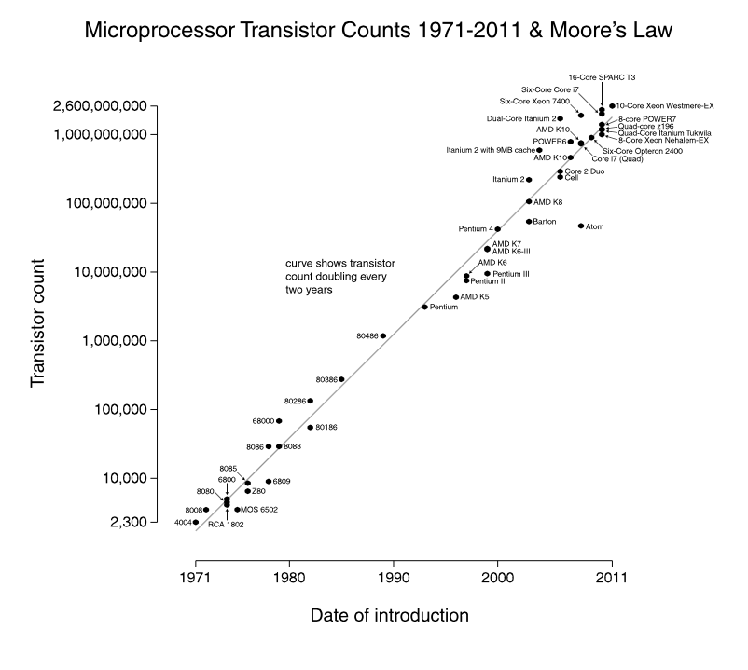
Introduction to HPC and why it’s useful
Notes:
Talk about graphics cards and problems that are not embarrassingly parallel, talk about Moore’s law and the revlopution of computing

Slide 7
Introduction to HPC and why it’s useful
Jan 2015 update: $6.7 billion
Notes:
Talk about graphics cards and problems that are not embarrassingly parallel, talk about Moore’s law and the revlopution of computing

Slide 8
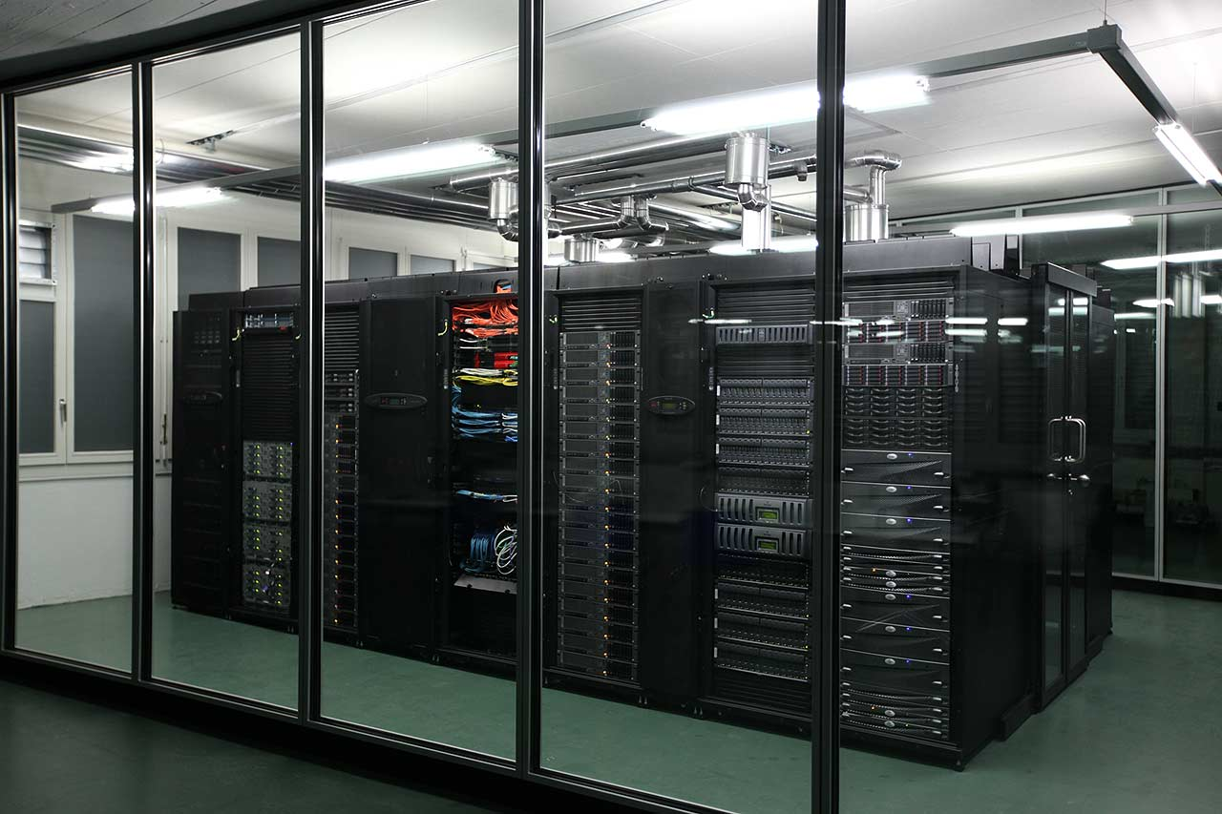
Introduction to HPC and why it’s useful
Embarrassingly parallel problems
Graphics
Simulations with multiple parameters
Notes:
Talk about graphics cards and problems that are not embarrassingly parallel, talk about Moore’s law and the revlopution of computing

Slide 9
Introduction to HPC and why it’s useful
Embarrassingly parallel problems
Graphics
Simulations with multiple parameters
Non embarrassingly parallel problems
Fluid dynamics
A lot of the tasks run by a single program
Notes:
Talk about graphics cards and problems that are not embarrassingly parallel, talk about Moore’s law and the revlopution of computing

Slide 10
How do you parallelize your code?
as.numeric(Sys.getenv("PBS_ARRAY_INDEX"))
Should be used in your code to give a simulation number
Before
Simulation
Notes:
Talk about graphics cards and problems that are not embarrassingly parallel, talk about Moore’s law and the revlopution of computing

Slide 11
How do you parallelize your code?
as.numeric(Sys.getenv("PBS_ARRAY_INDEX"))
Should be used in your code to give a simulation number
Before
Now
Simulation
Simulation 1
Simulation 2
Simulation 3
Notes:
Talk about graphics cards and problems that are not embarrassingly parallel, talk about Moore’s law and the revlopution of computing

Slide 12
How do you parallelize your code?
as.numeric(Sys.getenv("PBS_ARRAY_INDEX"))
Should be used in your code to give a simulation number
Before
Now
Simulation
Simulation 1
Simulation 2
Simulation 3
Notes:
Talk about graphics cards and problems that are not embarrassingly parallel, talk about Moore’s law and the revlopution of computing

Slide 13
Using your PC
for ( i in 1 : 10 )
{
do_simulation( i )
}

Slide 14
Using your PC
for ( i in 1 : 10 )
{
do_simulation( i )
}
Shell script on the cluster
Using HPC
i <- as.numeric(Sys.getenv("PBS_ARRAY_INDEX"))
do_simulation( i )
i <- as.numeric(Sys.getenv("PBS_ARRAY_INDEX"))
do_simulation( i )
i <- as.numeric(Sys.getenv("PBS_ARRAY_INDEX"))
do_simulation( i )
i <- as.numeric(Sys.getenv("PBS_ARRAY_INDEX"))
do_simulation( i )
i <- as.numeric(Sys.getenv("PBS_ARRAY_INDEX"))
do_simulation( i )
i <- as.numeric(Sys.getenv("PBS_ARRAY_INDEX"))
do_simulation( i )
i <- as.numeric(Sys.getenv("PBS_ARRAY_INDEX"))
do_simulation( i )
i <- as.numeric(Sys.getenv("PBS_ARRAY_INDEX"))
do_simulation( i )
i <- as.numeric(Sys.getenv("PBS_ARRAY_INDEX"))
do_simulation( i )
i <- as.numeric(Sys.getenv("PBS_ARRAY_INDEX"))
do_simulation( i )

Slide 15
How do you parallelize your code?
as.numeric(Sys.getenv("PBS_ARRAY_INDEX"))
Should be used in your code to give a simulation number
Before
Now
Simulation
Any seed
Simulation 1
Any seed ?
Simulation 2
Any seed ?
Simulation 3
Any seed ?
Notes:
Talk about graphics cards and problems that are not embarrassingly parallel, talk about Moore’s law and the revlopution of computing

Slide 16
How do you parallelize your code?
as.numeric(Sys.getenv("PBS_ARRAY_INDEX"))
Should be used in your code to give a simulation number
Pseudo random numbers
Given a certain random number seed, you get the same sequence of random numbers every time
Each simulation should have a different seed
Simulation 1
Seed
= 1
Simulation 2
Seed
= 2
Simulation 3
Seed
= 3
Notes:
Talk about graphics cards and problems that are not embarrassingly parallel, talk about Moore’s law and the revlopution of computing

Slide 17
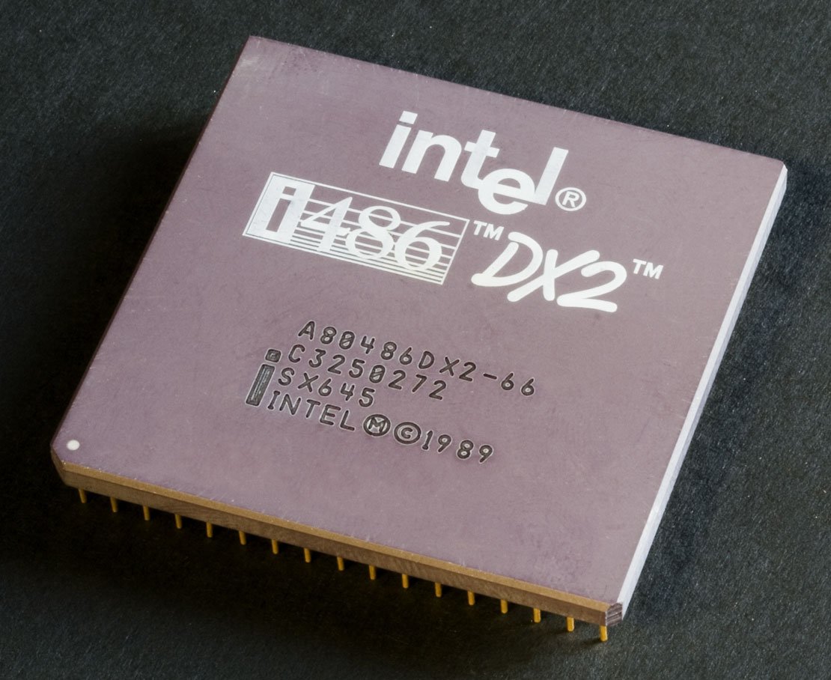
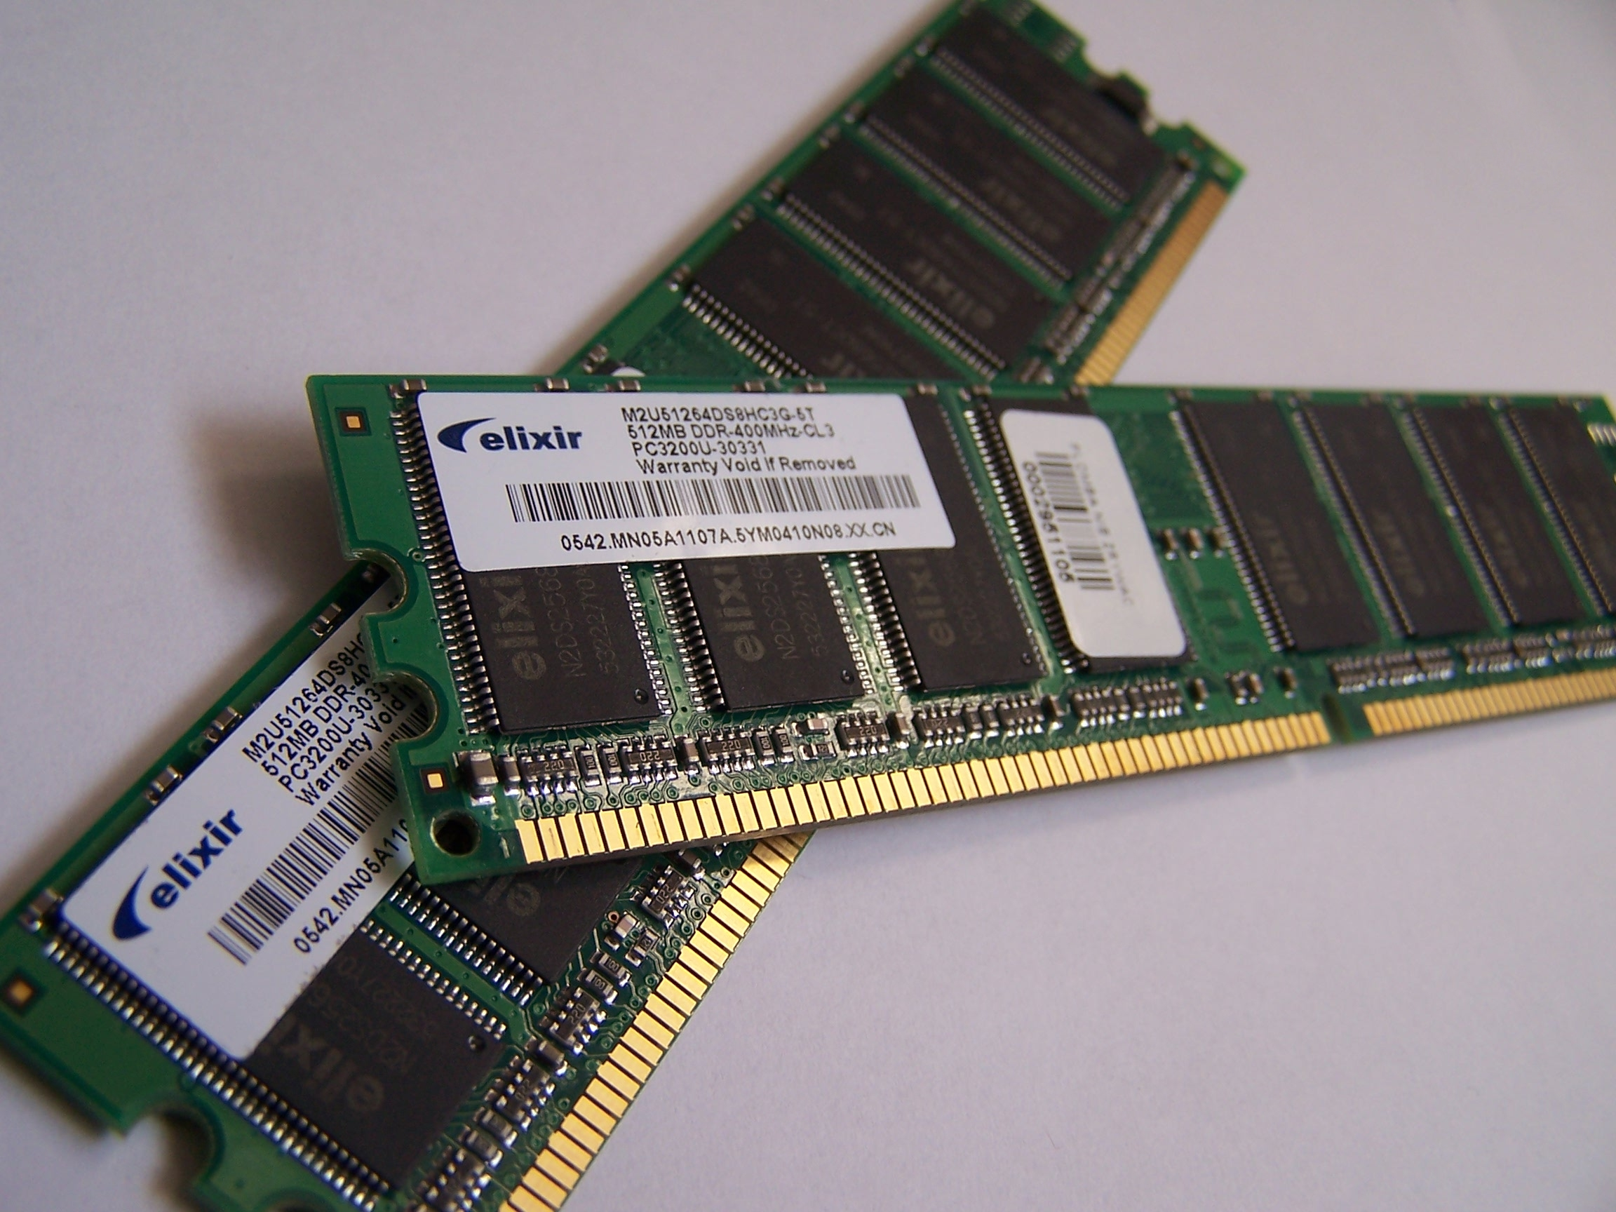
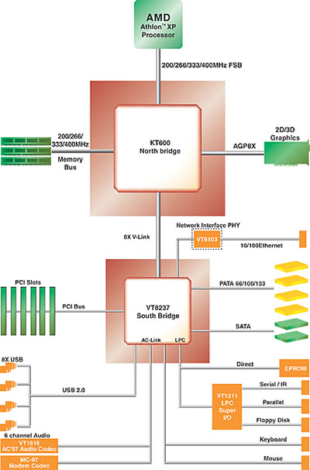
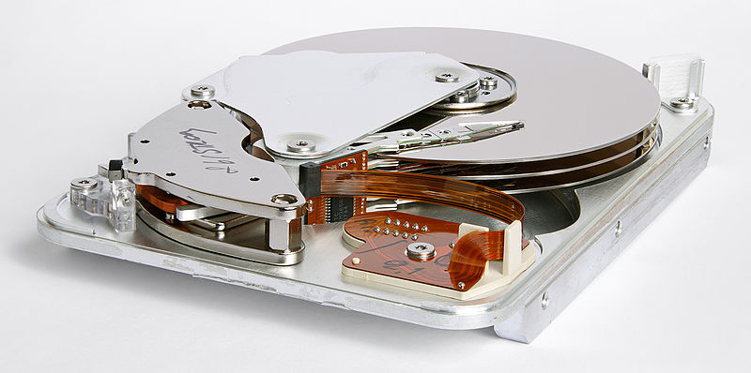
Handling memory
Notes:
Talk about graphics cards and problems that are not embarrassingly parallel, talk about Moore’s law and the revlopution of computing

Slide 18
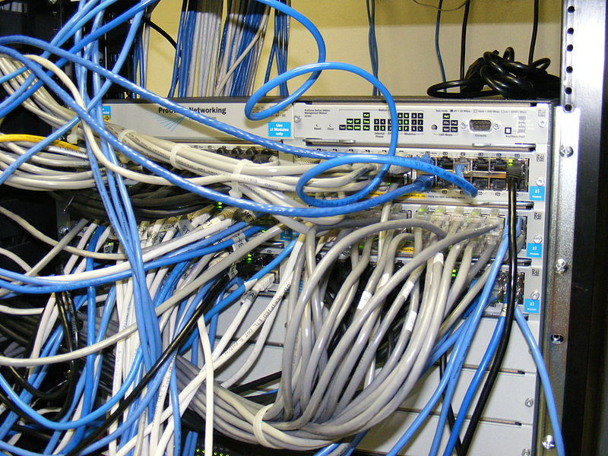
Handling memory
Notes:
Talk about graphics cards and problems that are not embarrassingly parallel, talk about Moore’s law and the revlopution of computing

Slide 19
Handling memory
Save your results in memory and then write to disk at the end
Notes:
Talk about graphics cards and problems that are not embarrassingly parallel, talk about Moore’s law and the revlopution of computing

Slide 20
Handling memory
Save your results in memory and then write to disk at the end
Output your code to a series of files
Simulation 1
Output1.rda
Seed
= 1
Simulation 2
Output2.rda
Seed
= 2
Simulation 3
Output3.rda
Seed
= 3
Notes:
Talk about graphics cards and problems that are not embarrassingly parallel, talk about Moore’s law and the revlopution of computing

Slide 21
Handling memory
Save your results in memory and then write to disk at the end
Output your code to a series of files
Write local code to read in your series of files automatically
Simulation 1
Output1.rda
Seed
= 1
Simulation 2
Output2.rda
Seed
= 2
Simulation 3
Output3.rda
Seed
= 3
Notes:
Talk about graphics cards and problems that are not embarrassingly parallel, talk about Moore’s law and the revlopution of computing

Slide 22
Handling memory
Save your results in memory and then write to disk at the end
Output your code to a series of files
Write local code to read in your series of files automatically
Simulation 1
Output1.rda
Seed
= 1
Simulation 2
Output2.rda
Seed
= 2
Simulation 3
Output3.rda
Seed
= 3
Notes:
Talk about graphics cards and problems that are not embarrassingly parallel, talk about Moore’s law and the revlopution of computing

Slide 23
Handling memory
Save your results in memory and then write to disk at the end
Output your code to a series of files
Write local code to read in your series of files automatically
Seed
X
1
2
3
4
50
50
21
21
Simulation 1
Output1.rda
Seed
= 1
X
= 50
Simulation 2
Output2.rda
Seed
= 2
X
= 50
Simulation 3
Output3.rda
Seed
= 3
X
= 21
Simulation 4
Output4.rda
Seed
= 4
X
= 21
Notes:
Talk about graphics cards and problems that are not embarrassingly parallel, talk about Moore’s law and the revlopution of computing

Slide 24
Handling memory
Save your results in memory and then write to disk at the end
Output your code to a series of files
Write local code to read in your series of files automatically
Build a timer into your code
Test your code locally to know your memory and time requirements
Notes:
Talk about graphics cards and problems that are not embarrassingly parallel, talk about Moore’s law and the revlopution of computing

Slide 25
Shell script on the cluster
i <- as.numeric(Sys.getenv("PBS_ARRAY_INDEX"))
do_simulation( i )
i <- as.numeric(Sys.getenv("PBS_ARRAY_INDEX"))
do_simulation( i )
i <- as.numeric(Sys.getenv("PBS_ARRAY_INDEX"))
do_simulation( i )
i <- as.numeric(Sys.getenv("PBS_ARRAY_INDEX"))
do_simulation( i )
i <- as.numeric(Sys.getenv("PBS_ARRAY_INDEX"))
do_simulation( i )
i <- as.numeric(Sys.getenv("PBS_ARRAY_INDEX"))
do_simulation( i )
i <- as.numeric(Sys.getenv("PBS_ARRAY_INDEX"))
do_simulation( i )
i <- as.numeric(Sys.getenv("PBS_ARRAY_INDEX"))
do_simulation( i )
i <- as.numeric(Sys.getenv("PBS_ARRAY_INDEX"))
do_simulation( i )
i <- as.numeric(Sys.getenv("PBS_ARRAY_INDEX"))
do_simulation( i )
do_simulation <- function( i )
{
# set random seed as i
# select your simulation parameters
# do your simulation
# save your output in a file named …i…
# include a timer
}

Slide 26
Imperial College high performance computing hpc.ic.ac.uk
The practice of running code on a cluster
cx1
A cluster of many ordinary computers
cx2
Massively parallel system
ax4
Large shared memory tasks
High-Throughput
High-End
Big data
http://www.imperial.ac.uk/admin-services/ict/self-service/research-support/rcs/computing/

Slide 27
Imperial College high performance computing hpc.ic.ac.uk
The practice of running code on a cluster
cx1
A cluster of many ordinary computers
cx2
Massively parallel system
ax4
Large shared memory tasks
High-Throughput
High-End
Big data
http://www.imperial.ac.uk/admin-services/ict/self-service/research-support/rcs/computing/

Slide 28

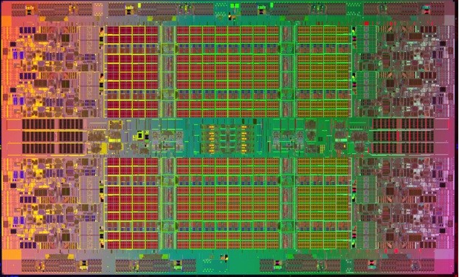
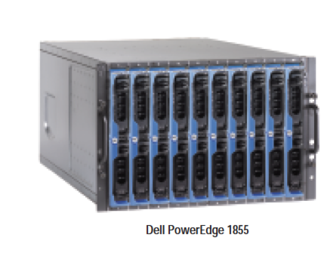
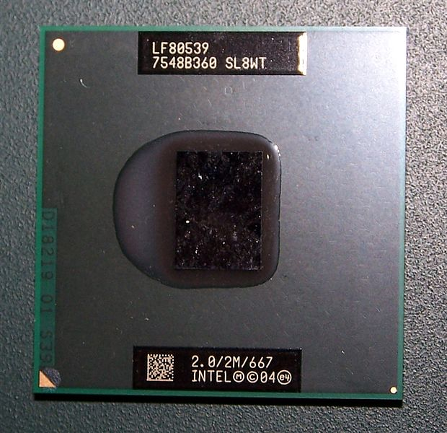
The Imperial College high performance computing PC cluster cx1.hpc.ic.ac.uk
Notes:
12192 cores on cx1 (2013 jan)
76*10*2*8
48 logical CPUs, 128GB of memory

Slide 29

The Imperial College high performance computing PC cluster cx1.hpc.ic.ac.uk

Slide 30
The Imperial College high performance computing PC cluster cx1.hpc.ic.ac.uk
Login node
your portal to cx1
Login.cx1.hpc.ic.ac.uk
Login

Slide 31
The Imperial College high performance computing PC cluster cx1.hpc.ic.ac.uk
Login node
your portal to cx1
Login.cx1.hpc.ic.ac.uk
Queue
Login

Slide 32
The Imperial College high performance computing PC cluster cx1.hpc.ic.ac.uk
Login node
your portal to cx1
Login.cx1.hpc.ic.ac.uk
Queue
Login
R Studio

Slide 33
The Imperial College high performance computing PC cluster cx1.hpc.ic.ac.uk
Login node
your portal to cx1
Login.cx1.hpc.ic.ac.uk
Queue
Login
R Studio
Jupyter

Slide 34
Where your data is stored…
$HOME
Backed up main area
1Tb

Slide 35
Where your data is stored…
ephemeralFor running larger jobs
30 days lifetime
$HOME
Backed up main area
1Tb

Slide 36
Where your data is stored…
You
ephemeralFor running larger jobs
30 days lifetime
$HOME
Backed up main area
1Tb
You

Slide 37
Where your data is stored…
You
ephemeralFor running larger jobs
30 days lifetime
$HOME
Backed up main area
1Tb
$TMPDIR
Ignore these temporary files, but be careful you don’t lose work in here!…
You

Slide 38
Where your data is stored…
You
Queue
ephemeralFor running larger jobs
30 days lifetime
$HOME
Backed up main area
1Tb
$TMPDIR
Ignore these temporary files, but be careful you don’t lose work in here!…
You

Slide 39
Where your data is stored…
You
Queue
This is your working directory
ephemeralFor running larger jobs
30 days lifetime
$HOME
Backed up main area
1Tb
$TMPDIR
Ignore these temporary files, but be careful you don’t lose work in here!…
You

Slide 40
Where your data is stored…
Queue
You
Queue
This is your working directory
ephemeralFor running larger jobs
30 days lifetime
$HOME
Backed up main area
1Tb
$TMPDIR
Ignore these temporary files, but be careful you don’t lose work in here!…
You

Slide 41
Where your data is stored…
Queue
You
Queue
This is your working directory
ephemeralFor running larger jobs
30 days lifetime
$HOME
Backed up main area
1Tb
$TMPDIR
Ignore these temporary files, but be careful you don’t lose work in here!…
You
You!!

Slide 42
Where your data is stored…
Queue
You
Queue
This is your working directory
ephemeralFor running larger jobs
30 days lifetime
$HOME
Backed up main area
1Tb
$TMPDIR
Ignore these temporary files, but be careful you don’t lose work in here!…
You
You!!

Slide 43
Step 1: get your code onto the cluster
Go to filezilla-project.org
Download FileZilla Client and install it.
Open FileZilla and put in the following settings
Host: sftp://login.cx1.hpc.ic.ac.uk
Username: your username for all Imperial services
Password: your usual Imperial password
Port: 22
Press the Quickconnect button
Copy your files and folders across onto HPC.
Notes:
For the massively parallel system SGI Altix ICE (cx2):
ssh to login.cx2.hpc.ic.ac.uk
For the very large shared memory system SGI Altix UV (ax3):
ssh to ax3.hpc.ic.ac.uk

Slide 44
Step 1: get your code onto the cluster
Alternative method if you prefer command line…
Use sftp: from the directory of your code in a shell window type ….
sftp username@login.cx1.hpc.ic.ac.uk
You will be asked for your standard cluster password
put filename.R
exit
Or use scp:
scp path/to/file.txt username@login.cx1.hpc.ic.ac.uk:/home/username/
Also see separate notes to be shared
Notes:
For the massively parallel system SGI Altix ICE (cx2):
ssh to login.cx2.hpc.ic.ac.uk
For the very large shared memory system SGI Altix UV (ax3):
ssh to ax3.hpc.ic.ac.uk

Slide 45
Step 2: log into the cluster
Use ssh: from a shell window type ….
Ssh –l username login.cx1.hpc.ic.ac.uk
You will be asked for your standard cluster password
Now it’s as though you were sitting with a shell open at the login node.
ls (will list the files in $HOME)
mkdir foldername (make a new folder)
mv filename $HOME/foldername (move)
cd foldername (change directory)
cat filename (see your file to check it’s contents)
module load anaconda3/personal
anaconda-setup (set up anaconda – one time only)
conda install r (install R – one time only)
Notes:
For the massively parallel system SGI Altix ICE (cx2):
ssh to login.cx2.hpc.ic.ac.uk
For the very large shared memory system SGI Altix UV (ax3):
ssh to ax3.hpc.ic.ac.uk

Slide 46
Step 3: make a file for your shell script
This is the list of instructions to be executed when you get to the front of the queue is written in shell script. It should be a .sh file
Do not run code on the login node – always write a shell script and wait in the queue.
If you type cat > filename.sh
You will then get the chance to type text (pressing enter for new lines) and the cat command will make the file containing the text that you typed.
When you are finished typing the contents of your new file press control and D to complete the process.
Type cat filename.sh to check that your file is correct before submitting it to the queue.
Notes:
For the massively parallel system SGI Altix ICE (cx2):
ssh to login.cx2.hpc.ic.ac.uk
For the very large shared memory system SGI Altix UV (ax3):
ssh to ax3.hpc.ic.ac.uk

Slide 47
Step 3 continued: your shell script file
#!/bin/bash
#PBS -l walltime=12:00:00
#PBS -l select=1:ncpus=1:mem=1gb
module load anaconda3/personal
echo "R is about to run"
R --vanilla < $HOME/Rtest/ForwardsNTC_V5.R
mv datafilename* $HOME
echo "R has finished running"
# this is a comment at the end of the file
Notes:
Check that you have new line caracters in properly (don’t just copy and paste)

Slide 48
Step 3 continued: your shell script file
#!/bin/bash
#PBS -l walltime=12:00:00
#PBS -l select=1:ncpus=1:mem=1gb
module load anaconda3/personal
echo "R is about to run”
R --vanilla < $HOME/Rtest/ForwardsNTC_V5.R
mv datafilename* $HOME
echo "R has finished running”
# this is a comment at the end of the file
You can run Python code too –
just use different commands here
Notes:
Check that you have new line caracters in properly (don’t just copy and paste)

Slide 49
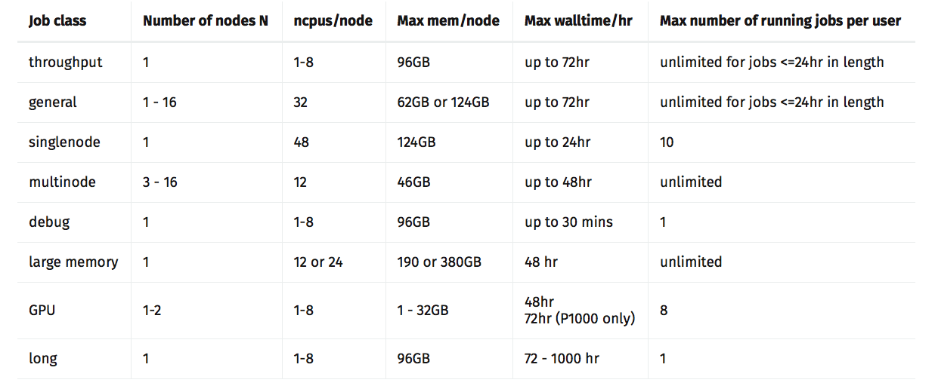
Step 3 continued: job sizing

Slide 50
Step 4: submitting your job to the cluster
You are now in the $HOME directory with your code and shell script both written.
To submit your job type
qsub -J 1-32 filename.sh
qstat (S changes from Q to B when running)
If you want to delete a job
qstat
qdel job-id[] (the [] is for array jobs only)
qstat will give you a list of jobs and you would get the job-id from there.
Notes:
For the massively parallel system SGI Altix ICE (cx2):
ssh to login.cx2.hpc.ic.ac.uk
For the very large shared memory system SGI Altix UV (ax3):
ssh to ax3.hpc.ic.ac.uk

Slide 51
Step 5: check that all is well
Wait 5-10 minutes then check that nothing has gone wrong.
qstat (is your job running still)
ls (are output files as expected)
cat filename.sh.ejob-id.index
(are error files empty?)
cat filename.sh.ojob-id.index
(are standard output files as expected)
qstat (is your job running still)
exit (you’re done for now come back later)
Notes:
For the massively parallel system SGI Altix ICE (cx2):
ssh to login.cx2.hpc.ic.ac.uk
For the very large shared memory system SGI Altix UV (ax3):
ssh to ax3.hpc.ic.ac.uk

Slide 52
Step 5 continued: how jobs are run
What we
might think
What really happens
time
time

Slide 53
Step 6: Getting your results back
qstat (is your job running still)
cd $HOME
ls (output files as expected?)
cat output filename (contents as expected?)
cat filename.sh.ejob-id.index
(error files empty?)
cat filename.sh.ojob-id.index
(standard output files as expected?)
tar czvf filename.tgz *
mv filename.tgz $HOME
Notes:
For the massively parallel system SGI Altix ICE (cx2):
ssh to login.cx2.hpc.ic.ac.uk
For the very large shared memory system SGI Altix UV (ax3):
ssh to ax3.hpc.ic.ac.uk

Slide 54
Step 6 continued: sftp to get results
exit
Use sftp: from a new directory on your own computer of where you want the results to be. Open a shell and type …
sftp username@login.cx1.hpc.ic.ac.uk
You will be asked for your standard cluster password
get filename.tgz
exit
Your results are now all on your own computer
tar xzvf filename.tgz
Your results are now complete uncompressed and ready for use. Now you need to write some R code to read in and analyze all those file.
Notes:
For the massively parallel system SGI Altix ICE (cx2):
ssh to login.cx2.hpc.ic.ac.uk
For the very large shared memory system SGI Altix UV (ax3):
ssh to ax3.hpc.ic.ac.uk

Slide 55
For your excercises
You’ll be asked to adapt your code from yesterday to run on the cluster for a much bigger ecological community size
You’ll need to collect species abundance data as before and average over a large number of parallel simulations.
Notes:
Talk about graphics cards and problems that are not embarrassingly parallel, talk about Moore’s law and the revlopution of computing

Slide 56
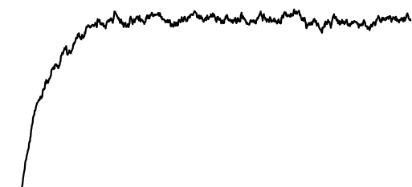
For your excercises
You’ll be asked to adapt your code from yesterday to run on the cluster for a much bigger ecological community size
You’ll need to collect species abundance data as before and average over a large number of parallel simulations.
v
v
Notes:
Talk about graphics cards and problems that are not embarrassingly parallel, talk about Moore’s law and the revlopution of computing

Slide 57
For your excercises
You’ll be asked to adapt your code from yesterday to run on the cluster for a much bigger ecological community size
You’ll need to collect species abundance data as before and average over a large number of parallel simulations.
v
v
Notes:
Talk about graphics cards and problems that are not embarrassingly parallel, talk about Moore’s law and the revlopution of computing

Slide 58
For your excercises
You’ll be asked to adapt your code from yesterday to run on the cluster for a much bigger ecological community size
You’ll need to collect species abundance data as before and average over a large number of parallel simulations.
Notes:
Talk about graphics cards and problems that are not embarrassingly parallel, talk about Moore’s law and the revlopution of computing

Slide 59
For your excercises
You’ll be asked to adapt your code from yesterday to run on the cluster for a much bigger ecological community size
You’ll need to collect species abundance data as before and average over a large number of parallel simulations.
Notes:
Talk about graphics cards and problems that are not embarrassingly parallel, talk about Moore’s law and the revlopution of computing

Slide 60
For your excercises
You’ll be asked to adapt your code from yesterday to run on the cluster for a much bigger ecological community size
You’ll need to collect species abundance data as before and average over a large number of parallel simulations.
Notes:
Talk about graphics cards and problems that are not embarrassingly parallel, talk about Moore’s law and the revlopution of computing

Slide 61
For your excercises
You’ll be asked to adapt your code from yesterday to run on the cluster for a much bigger ecological community size
You’ll need to collect species abundance data as before and average over a large number of parallel simulations.
Use a “burn in” period and check the species abundance distribution periodically.
Notes:
Talk about graphics cards and problems that are not embarrassingly parallel, talk about Moore’s law and the revlopution of computing

Slide 62
For your excercises
You’ll be asked to adapt your code from yesterday to run on the cluster for a much bigger ecological community size
You’ll need to collect species abundance data as before and average over a large number of parallel simulations.
Use a “burn in” period and check the species abundance distribution periodically. You should plot species richness against time and make a conservative judgment, but for neutral theory 8 * metacommunity size complete turnovers of the community is a good rule of thumb.
Notes:
Talk about graphics cards and problems that are not embarrassingly parallel, talk about Moore’s law and the revlopution of computing

Slide 63
Notes:
Take home messages

Slide 64
DO NOT …
Use the cluster without knowing memory and time requirements
Run jobs on the login node
Try to use cx2 or ax4 parts of the cluster
Output data to the hard disk regularly
Use the same random seed for your simulations
Copy and paste your shell script
Leave your results in $TMPDIR
Waste too much of your own time optimizing your code
Run code on the cluster that hasn’t been tested locally first
Notes:
Take home messages

Slide 65
DO …
Use the cluster for jobs that take a long time locally.
Optimize your code if there’s going to be a huge benefit
Run repeat readings and different parameters as separate jobs.
Run jobs that take between 30 mins and 3 days to execute.
Write your shell script on the cluster itself.
Make your code output each result in a differently named file.
Check periodically that all is well on the cluster
Be ambitious – you can do loads of great stuff with a cluster.
imperial.ac.uk/admin-services/ict/self-service/research-support/rcs
wiki.imperial.ac.uk/display/HPC/High+Performance+Computing
Notes:
Take home messages

